Slide 1
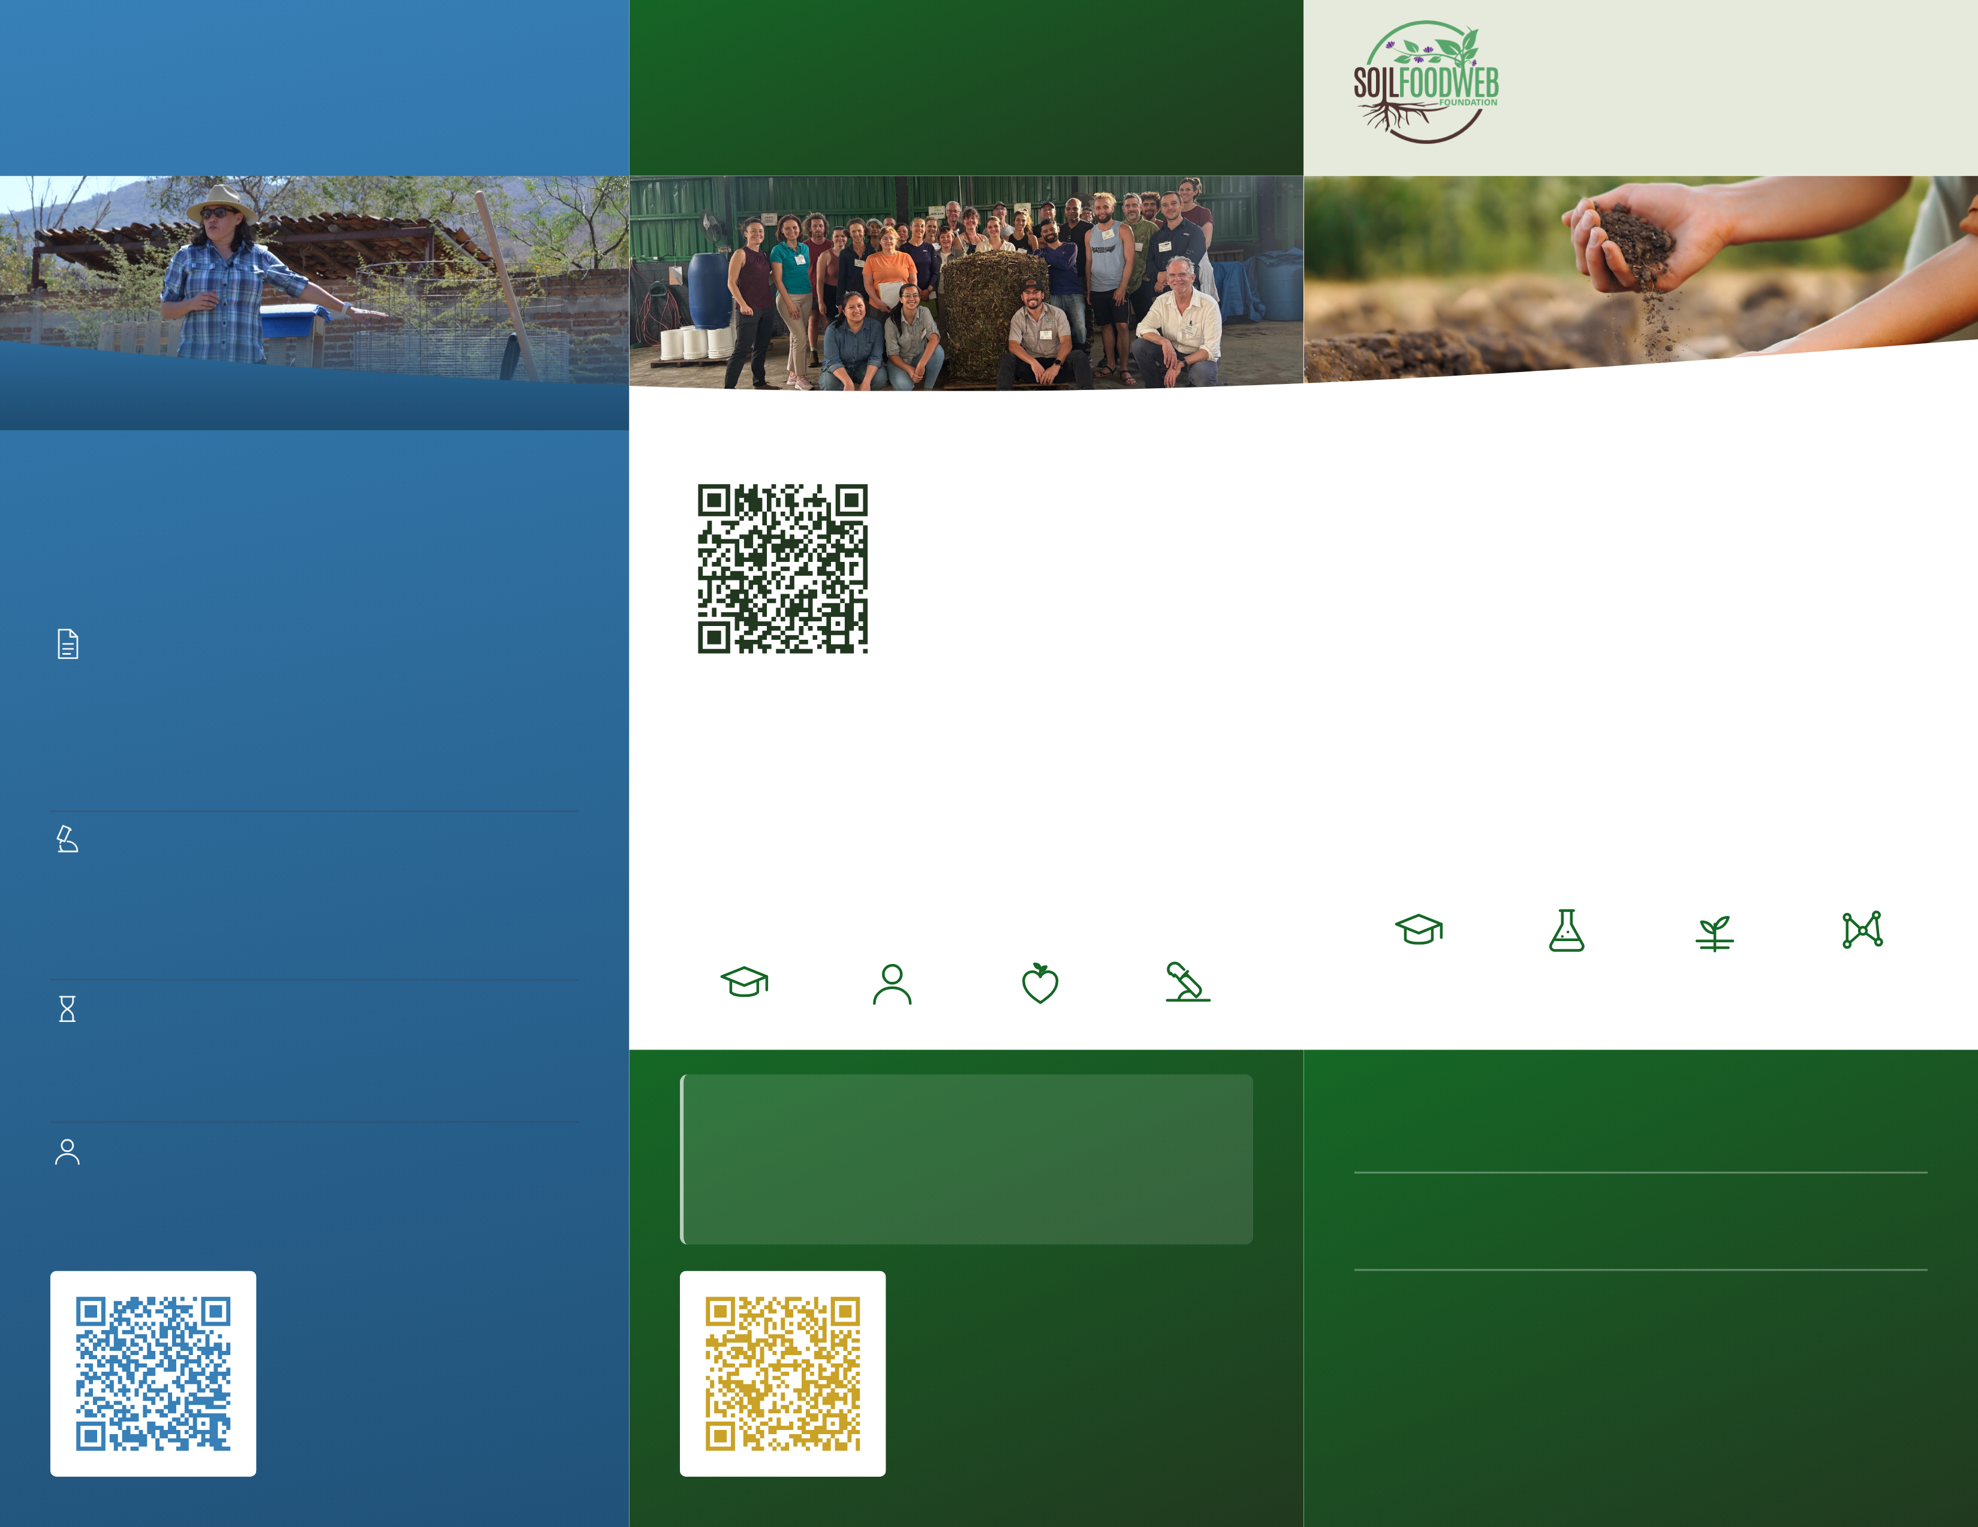
TEACHING
COMMUNITY
Soil Food Web
Foundation
Anyone, anywhere, can
learn to restore living soil.
A global community amplifies
the impact of this vital work.
A 501(c)(3) nonprofit
A mentor teaching on working land.
A workshop group around a finished compost pile.
The soil beneath
our farms and
forests is alive.
From curiosity through to professional practice.
Everyone starts with the Foundation Courses, and
where you go next depends on whether you want to
apply your skills to your own land or help others
improve their soils.
Join the free online
community
Meet other people in the regenerative
agricultural space. Get your questions
answered by other practitioners of the soil
food web approach who share the desire to
restore the world's soils.
A web of bacteria, fungi, protozoa, nematodes and
microarthropods feeds plants, builds soil, stores carbon
and cleans water when it is intact.
Foundation Courses
sfw.one/brochure-community
You'll learn the science of the soil food web, the organisms
and their roles, use of a microscope for biological analyses
and how biological amendments are made and applied. They
are online, self-paced, take about 150 hours to complete, and
are a prerequisite to any Advanced Program.
Dr. Elaine's soil food web approach is the key to rapid and
effective soil regeneration. Only with the complete soil food web
in place can the ecological functions of the soil be restored,
protecting and purifying the world's waterways, reversing
climate change and providing more nutritious foods. It's easy to
find your place in this movement. Reach out to discover
opportunities to join us as a student, volunteer, ambassador,
donor and partner. info@soilfoodweb.com
For forty-five years, Dr. Elaine Ingham mapped the Soil Food Web
and taught the world to restore it. We carry her legacy forward:
showing what is possible, teaching how to partner with life in the
soil, researching why things work or do not, and getting dirty
through direct action on working land. Living soil is the solution,
and it is beneath your feet.
Advanced Programs
Learn the practical application of the theory you learned in the
Foundation Courses through mentor-led Advanced Programs
on Soil Microscopy, BioComplete™ Compost Production,
Biological Liquid Amendments and Field Trial.
Accelerator Workshops
EDUCATION
RESEARCH
PRACTICE
COMMUNITY
The Advanced Programs as a group on working land, the whole
method at once. Held periodically with a host partner. Dates
on the school site.
STUDY
VOLUNTEER
DONATE
HOST
5441 S Macadam Ave Ste N
Portland, Oregon 97239
soilfoodweb.com
132+
Where it leads
Countries in our student and practitioner community
All four Advanced Programs carry the Soil Food Web
Consultant title; Soil Microscopy alone, the Lab Technician
title. Prices at school.soilfoodweb.com
Soil Food Web Foundation is a 501(c)(3) nonprofit organization, EIN 39-
4439236. The Soil Food Web School is a program of the Foundation.
10,000+
Individuals enrolled in our programs
Donate
45
Apply for a scholarship
Gifts fund open research, scholarships and
field projects. Tax-deductible to the extent
allowed by law.
Years of pioneering soil biology research behind the method
Scholarships prioritize applicants in
under-resourced regions.
Healing soil.
Feeding humanity.
Restoring the living world.
sfw.one/brochure-scholarship
sfw.one/brochure-donate

Slide 2
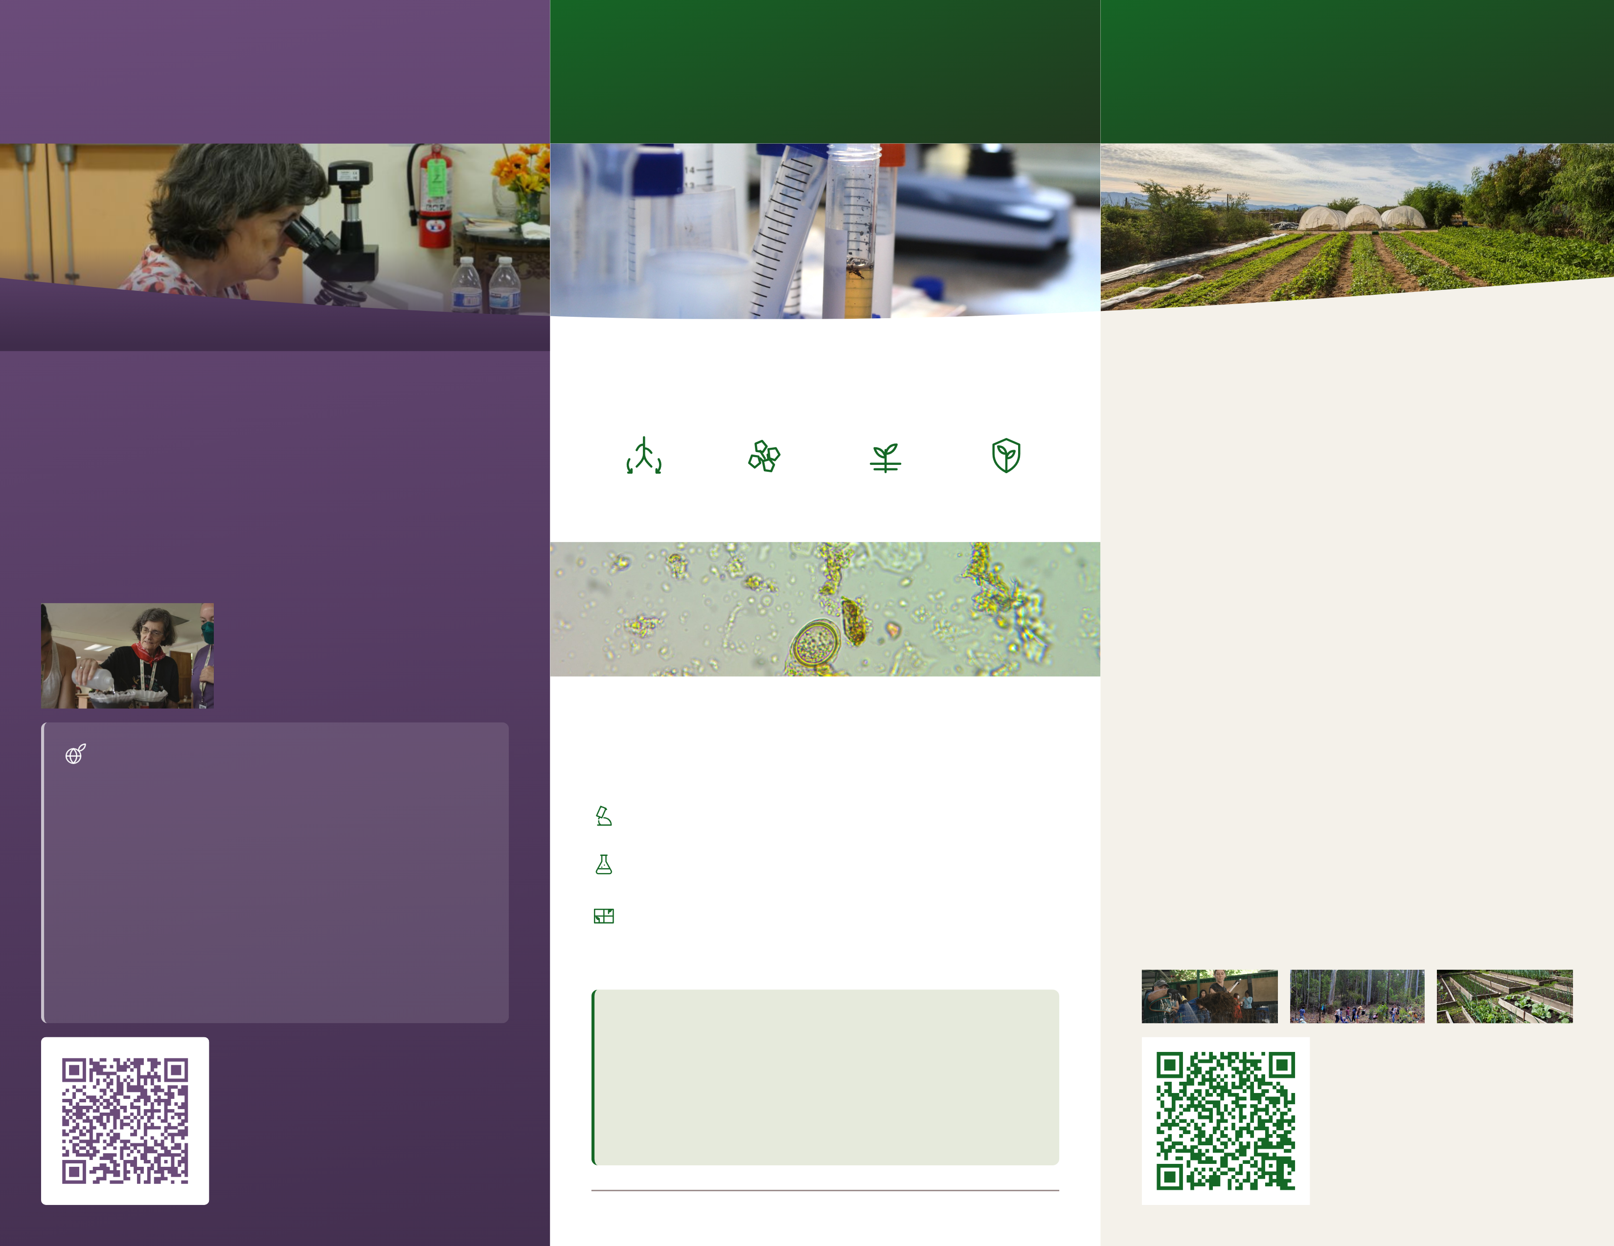
PRACTICE
Growers are already
implementing the soil
food web approach,
at every scale.
OUR STORY
RESEARCH
It began with one
scientist looking closer.
The science is open,
and anyone can test it.
Dr. Elaine Ingham at the microscope.
Soil samples beside the microscope.
Agroecology plots at Rancho Cacachilas.
The Soil Food Web Foundation was established in October 2025
to carry forward the life's work of Dr. Elaine Ingham, the
pioneering scientist whose research transformed our
understanding of soil biology and its central role in food
production, ecosystem health, and planetary regeneration.
What biologically complete, properly-structured soil
does
The basic methodology is universal; the application
is based upon locally-sourced materials. Our case
studies and field trials demonstrate the efficacy
across a range of soil types at every scale from
market gardens to massive industrial farming
operations.
She passed away in February 2026, and the work she started
continues through the Foundation, the school that is a part of it,
and Soil Food Web practitioners in more than 132 countries, who
are helping to restore the world's soils.
NUTRIENT
CYCLING
CREATES
SOIL
STRUCTURE
INHIBITS
WEED
PRESSURE
REDUCES
PESTS
AND DISEASE
Nick Padwick farms four thousand acres in Norfolk,
England. Roberto Silva works a hundred and forty in Piura,
Peru. Jenn Sirp grows on a quarter acre in California. Check
out their individual accounts of how the soil food web
approach changed their operations through reducing
inputs, creating better outputs and improving their bottom
lines.
Examine Dr. Ingham's publications here:
sfw.one/publications
Testate amoeba, 40x objective. Photograph: Joy Kaluf. A microbial count names
what is present in the sample and their relative numbers: bacteria, fungi,
protozoa, nematodes and microarthropods.
Though the projects run from backyard gardens to
expansive public parks, the same process is applicable. The
steps are the same at every scale: look at the biology under
a microscope, add what is missing to rebalance the
microbial content, then measure again to confirm microbial
counts are going in the expected directions.
WHY THIS MATTERS FOR CLIMATE
What we test before we recommend remediation
plans
Soil carbon sequestration is widely recognized as a part
of the solution to climate change impacts. Plants pull
carbon from the air and invest much of it in the soil, where
it is built into microbial bodies, aggregates and complex
fungal networks. A biological approach to soil
management reduces equipment emissions, reduces
fertilizer and irrigation needs and creates more nutritious
crops. Regenerating the world's soils using the Soil Food
Web Approach can improve atmospheric carbon levels.
Be part of the soil-ution!
Diagnostic first. Every recommendation starts with a
biological analysis under a microscope.
Measurable. We provide a relative count of various microbes
present in your soil or compost sample.
We partner with growers to teach them microscopy and
biological compost creation and application so they can
implement the approach where they farm, and document
the impacts.
Adaptation and retrofitting. We help you convert your
current operations to the soil food web approach, at any
scale.
We train people who help farmers to transition away from
using chemicals, to using biology. This results in
significant benefits to the farmer and to the environment,
as well as to the consumer. The method has been proven
effective on 6 continents and across all soil types, as
evidenced by our ever-increasing case study library.
Join our free online
community
Watch the case studies
Learn from and connect with other passionate
people in the regenerative agriculture space.
You can also register for our newsletter and
webinar series via the link in this QR code.
Growers filming their own soil, crop by
crop and climate by climate. Start with
one that looks like yours.
sfw.one/brochure-webinar
sfw.one/brochure-casestudies

